Slide 1





Predicting Falcon 9 First Stage Landing Success: A Cost-Effective Approach
Austin Liwanag
April 23, 2024

Slide 2


OUTLINE
Executive Summary
Introduction
Methodology
Results
Visualization – Charts
Dashboard
Discussion
Findings & Implications
Conclusion
Appendix

Slide 3

EXECUTIVE SUMMARY
Methodologies:
Data Collection
Data Wrangling
Exploratory Data Analysis (EDA)
Interactive Data Visualization
Machine Learning Prediction
Results:
Exploratory Data Analysis (EDA) results
Interactive dashboard
Machine Learning Prediction analysis

Slide 4

INTRODUCTION
Overview
SpaceX, founded by Elon Musk in 2002, has revolutionized space transportation with its ambitious goal of lessening costs and empowering the colonization of Mars. One of the key factors behind SpaceX’s accomplishment is its innovative reuse of the first stage of the Falcon 9 rocket. By reusing this critical component, SpaceX significantly lowers launch costs compared to other providers.
Objective
In our capstone project, we delve into predicting whether the Falcon 9 first stage will successfully land after a launch. By leveraging machine learning techniques, we aim to develop a predictive model that can regulate the likelihood of a fruitful landing. Join us on this breathtaking journey as we explore data, build models, and contribute to the future of space exploration.

Slide 5

METHODOLOGY
Data Collection
Gathering relevant data related to Falcon 9 launches.
Data Wrangling
Cleaning and formatting the collected data.
Exploratory Data Analysis (EDA)
Exploring patterns and insights.
Interactive Data Visualization
Creating visualizations to understand the data better.
Machine Learning Prediction
Leveraging classification algorithms to predict first stage landing outcomes.

Slide 6
Data Collection – SpaceX API
We collect and ensure the data is in the right format from an API that SpaceX offers.
Then, we request and parse SpaceX launch data using API calls.
Source:
https://github.com/Yosti-Light/SpaceX-capstone/blob/main/jupyter-labs-spacex-data-collection-api.ipynb

Slide 7
Data Collection – Web Scraping
We perform web scraping by extracting a Falcon 9 launch records table from web sources like a list of Falcon 9 and Falcon heavy launches page.
Using BeautifulSoup, we parse the table and convert it to a Pandas data frame for collecting information on launch outcomes, dates, and conditions.
Source:
https://github.com/Yosti-Light/SpaceX-capstone/blob/main/jupyter-labs-webscraping.ipynb

Slide 8
Data Wrangling
Some Exploratory Data Analysis (EDA) was used on the dataset to look for some patterns in the data and to find out what would be the label for training supervised models.
We determine Training Labels with 1 meaning a successful booster landing and 0 meaning it is unsuccessful.
Source:
https://github.com/Yosti-Light/SpaceX-capstone/blob/main/labs-jupyter-spacex-Data%20wrangling.ipynb

Slide 9
Exploratory Data Analysis (EDA) with SQL
If we want to know if the first stage will land, we can determine the cost of a launch.
If a company would like to bid against SpaceX for launch, we can use this information.
The SpaceX dataset consists of a record for each payload toted during a SpaceX mission.
So we load the dataset into a database and execute the required SQL queries.
Source:
https://github.com/Yosti-Light/SpaceX-capstone/blob/main/jupyter-labs-eda-sql-coursera_sqllite.ipynb

Slide 10
Exploratory Data Analysis (EDA) with Visualization
While performing Exploratory Data Analysis (EDA), we also prepare Data Feature Engineering using Pandas and Matplotlib.
To analyze data, we use scatterplots and bar plots to envision the relationship between Flight Number, Payload Mass, and Orbit.
Source:
https://github.com/Yosti-Light/SpaceX-capstone/blob/main/edadataviz.ipynb

Slide 11
Interactive Visual Analytics with Folium
To make a Folium map for SpaceX launch dataset visualization, we use markers, marker clusters, and lines.
Markers indicate all launch sites on a map.
Marker clusters indicate the success/failed launches for each site.
Lines calculate the distance between two coordinates.
Source:
https://github.com/Yosti-Light/SpaceX-capstone/blob/main/lab_jupyter_launch_site_location.ipynb

Slide 12
Build an Interactive Dashboard with Plotly Dash
On the Plotly dashboard, we make:
A pie chart for visualizing the total launch success counts per site. This makes it so that we know which sites are most successful. If we want to see the success or failure for a site, we can filter the chart using dcc.Dropdown().
A scatter plot for observing the correlation between mission outcomes and payload mass (kg). We can filter the chart using dcc.RangeSlider().
Source:
https://github.com/Yosti-Light/SpaceX-capstone/blob/main/spacex_dash_app.py

Slide 13
Machine Learning Prediction
Some Exploratory Data Analysis (EDA) and Training Labels were used to standardize the data and split it into two types of data: training and test.
We find the best hyperparameter with the help of an SVM, a classification tree, and logistic regression.
Source:
https://github.com/Yosti-Light/SpaceX-capstone/blob/main/SpaceX_Machine%20Learning%20Prediction_Part_5.ipynb

Slide 14
Results
Exploratory Data Analysis (EDA) results
Interactive dashboard
Machine Learning Prediction analysis

Slide 15
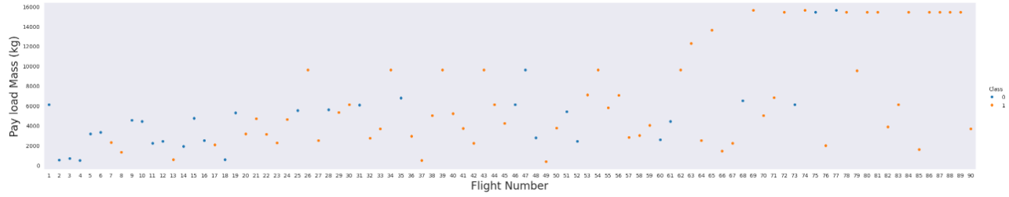
EXPLORATORY DATA ANALYSIS (EDA) - Flight Number vs. Payload Mass
The higher the flight number, the more likely the first stage will succeed in landing.
As the payload mass increases, the first stage is less likely to return.
So SpaceX has honed is landing competence over time. Later flights prioritized superior outcomes relating to recovery of the first stage.

Slide 16
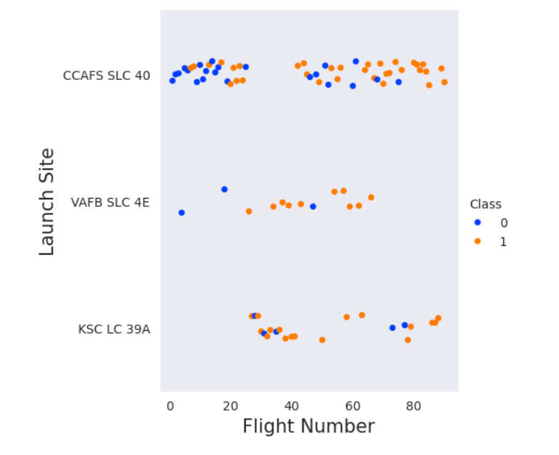
EXPLORATORY DATA ANALYSIS (EDA) - Flight Number vs. Launch Site
The clustering on this scatter plot could mean that launch sites are accompanying specific flight numbers.
Launches from a site like CCAFS SLC-40 might constantly use a certain range of flight numbers while another one like VAFB SLC-4E uses a different range.
This could be because of operational practices or mission types.

Slide 17
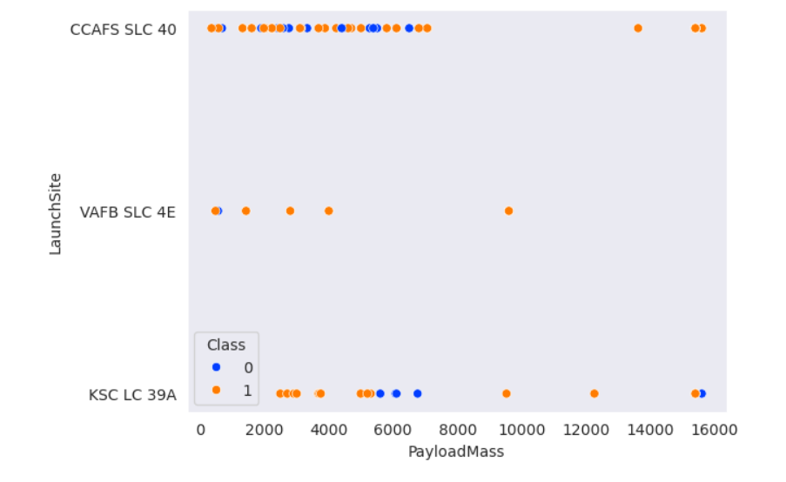
EXPLORATORY DATA ANALYSIS (EDA) - Payload Mass vs. Launch Site
The payload mass has a crucial role: heavy payloads are clearly linked to a lower likelihood of prosperous first-stage return.
If we observe the Payload Mass vs. Launch Site scatter point plot, we can see that VAFB-SLC does not have any rockets launched for mass greater than 10000.

Slide 18
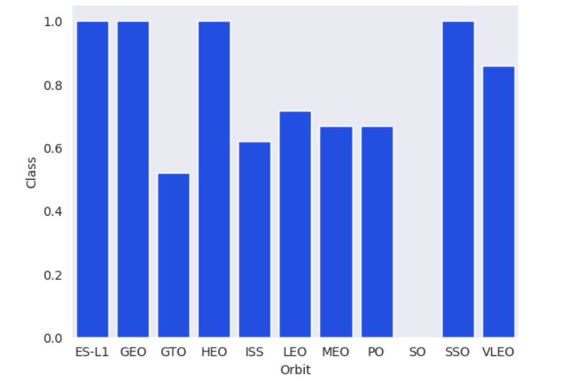
EXPLORATORY DATA ANALYSIS (EDA) - Success Rate vs. Orbit Type
Orbits like ES-L1, GEO, HEO, and SSO have a high success rate of 1.0. This could mean that these orbits are correlated with accomplished first-stage landings.
However, the SO orbit has a low rate of 0, meaning that suborbital launches are difficult in respect of first-stage recovery.

Slide 19
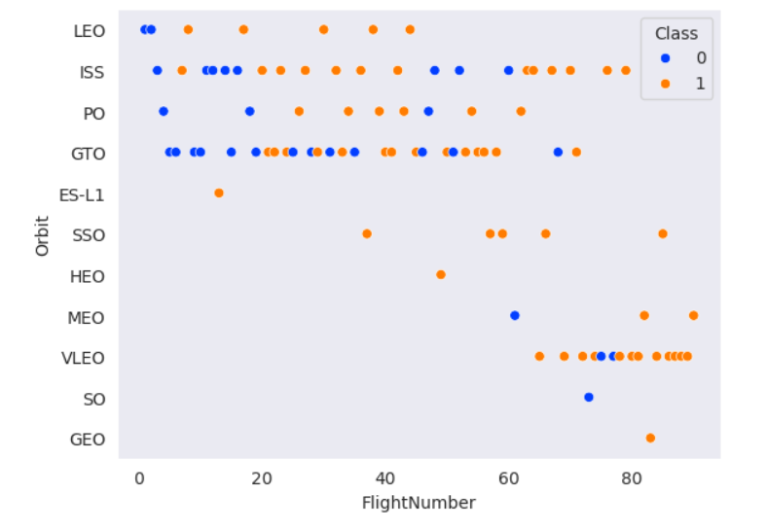
EXPLORATORY DATA ANALYSIS (EDA) - Flight Number vs. Orbit Type
We can see that in an orbit like LEO, the success appears related to the number of flights, although we see that there is no relationship between flight number when in GTO.

Slide 20
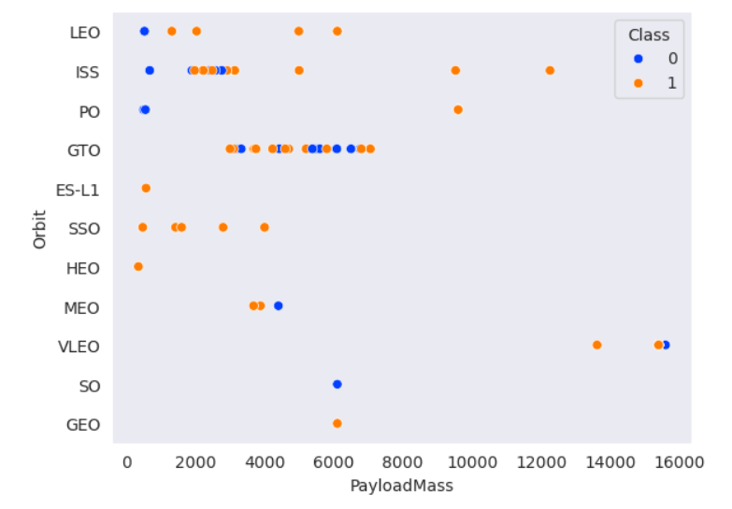
EXPLORATORY DATA ANALYSIS (EDA) - Payload Mass vs. Orbit Type
With hefty payload, the landing rates are more optimistic for LEO and ISS despite that GTO cannot be distinguished because both positive and negative landing rates are there.

Slide 21
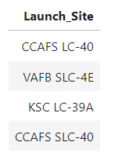
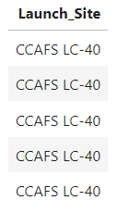
EXPLORATORY DATA ANALYSIS (EDA) - SQL
The query %sql SELECT DISTINCT LAUNCH_SITE FROM SPACEXTBL displays the names of the unique launch sites.
The query %sql SELECT LAUNCH_SITE FROM SPACEXTBL WHERE LAUNCH_SITE LIKE 'CCA%' LIMIT 5 displays five records with launch sites that begin with the string 'CCA'.

Slide 22



EXPLORATORY DATA ANALYSIS (EDA) - SQL
The query %sql SELECT SUM(PAYLOAD_MASS__KG_) AS TOTAL_PAYLOAD_MASS FROM SPACEXTBL WHERE CUSTOMER = 'NASA (CRS)' displays the total payload mass carried by boosters launched by NASA (CRS).
The query %sql SELECT AVG(PAYLOAD_MASS__KG_) AS AVERAGE_PAYLOAD_MASS FROM SPACEXTBL WHERE BOOSTER_VERSION = 'F9 v1.1' displays the average payload mass brought by booster version F9 v.11.
The query %sql SELECT min(date) FROM SPACEXTBL where "Landing_Outcome"='Success (ground pad)' lists the date when the first successful landing outcome in ground pad was attained.

Slide 23
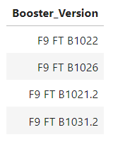
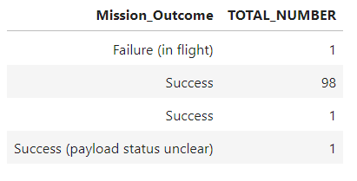
EXPLORATORY DATA ANALYSIS (EDA) - SQL
The query %sql SELECT BOOSTER_VERSION FROM SPACEXTBL WHERE ("Landing_Outcome" = 'Success (drone ship)') AND (PAYLOAD_MASS__KG_ BETWEEN 4000 AND 6000) lists the names of the boosters that succeeded in drone ship and have payload mass greater than 4000 but less than 6000.
The query %sql SELECT MISSION_OUTCOME, COUNT(MISSION_OUTCOME) AS TOTAL_NUMBER FROM SPACEXTBL GROUP BY MISSION_OUTCOME lists the total number of successful and failure mission outcomes.

Slide 24
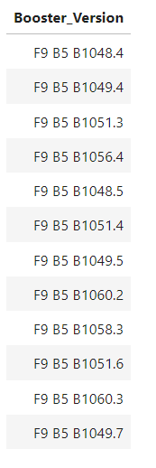
EXPLORATORY DATA ANALYSIS (EDA) - SQL
The query %sql SELECT DISTINCT(BOOSTER_VERSION) FROM SPACEXTBL WHERE PAYLOAD_MASS__KG_ =(SELECT MAX(PAYLOAD_MASS__KG_) FROM SPACEXTBL) lists the names of the booster versions which have carried the maximum payload mass.

Slide 25
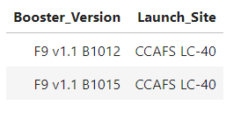
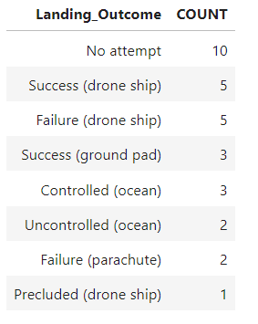
EXPLORATORY DATA ANALYSIS (EDA) - SQL
The query %sql SELECT "Booster_Version", "Launch_Site" FROM SPACEXTABLE WHERE "Landing_Outcome" = 'Failure (drone ship)' AND substr(Date,1,4) = '2015' lists the records that will show the month names(However, we cannot use monthnames on SQLite. Instead, we use substr(Date,6,2) for months and substr(Date,0,5)='2015' for year), failure landing outcomes in drone ship, booster versions, and launch site for the months in 2015.
The query %sql SELECT "LANDING_OUTCOME", COUNT(*) as 'COUNT' FROM SPACEXTBL WHERE substr(Date,1,4) || substr(Date,6,2) || substr(Date,9,2) between '20100604' and '20170320' GROUP BY "Landing_Outcome" ORDER BY "COUNT" DESC ranks the count of landing outcomes (e.g. Failure (drone ship) or Success (ground pad)) between the date 2010-06-04 and 2017-03-20 in descending order.

Slide 26
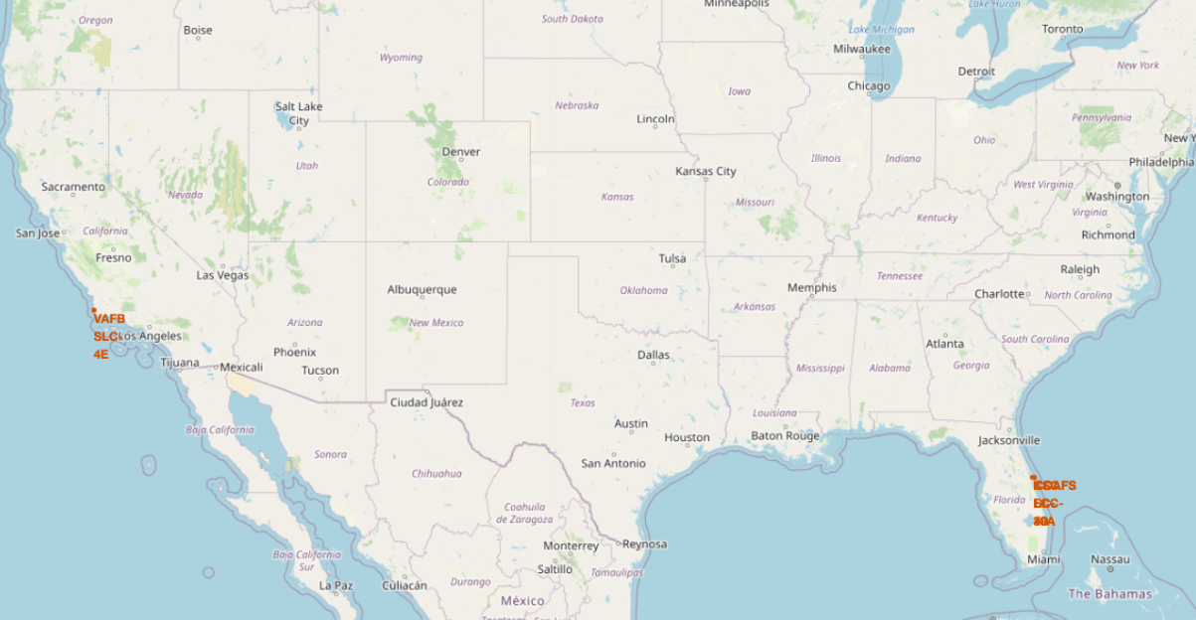
Interactive Map with Folium
All the launch sites are on the coasts to Florida and California.

Slide 27
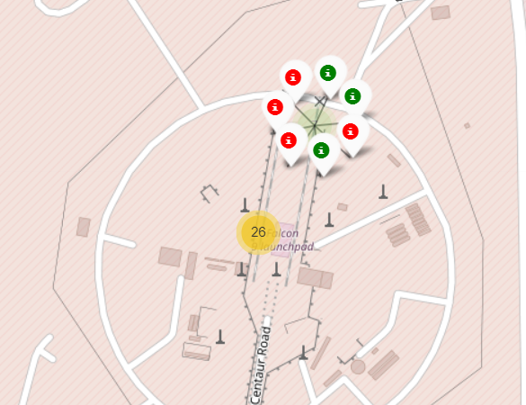
Interactive Map with Folium
For successful/failed launches, we use markers for all launch records. A green marker indicates a successful launch while a red marker indicates a failed launch. A launch only happens in one of the four sites, meaning that several launch records will have duplicate coordinates. For this, we use marker clusters.

Slide 28
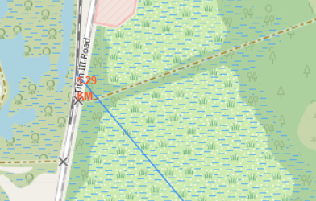
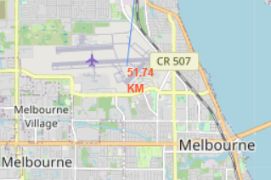
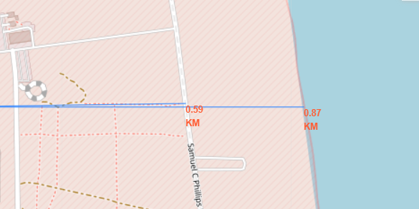
Interactive Map with Folium
After plotting distance lines to the proximities, we can see that:
The nearest railway is 1.29 km away.
The nearest highway is 0.59 km away.
The coastline is 0.87 km away.
The nearest city (Melbourne) is 51.74 km away.

Slide 29
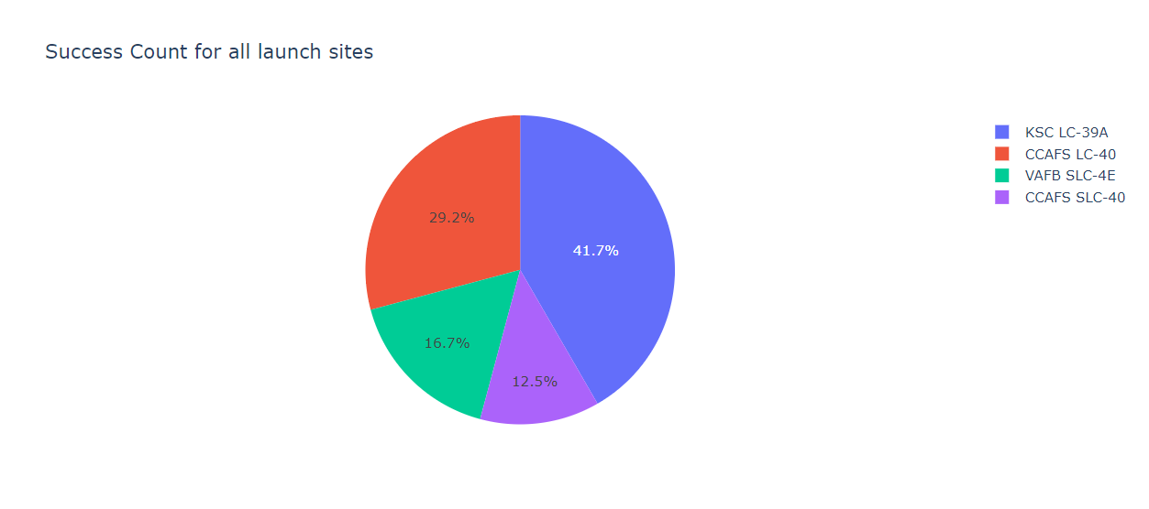
Interactive Dashboard with Plotly
We created a pie chart that shows the total success count for all four launch sites or a success count of a site.
The KSC LC-39A site had 41.7% of successful launches, so it had the most accomplished launches.

Slide 30
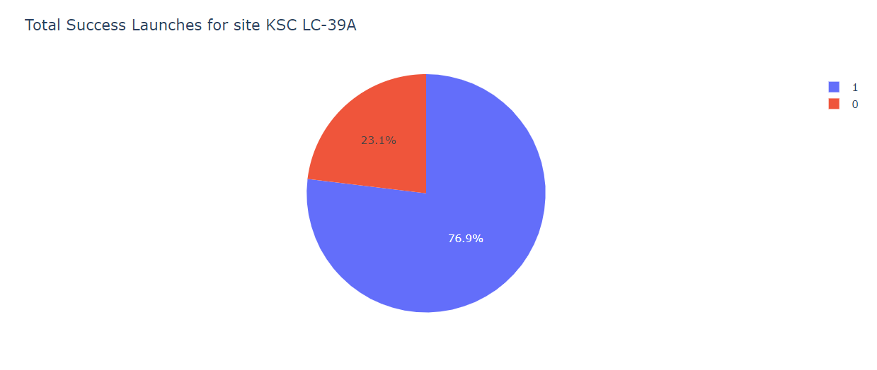
Interactive Dashboard with Plotly
The KSC LC-39A site also had 76.9% of successful launches, and its success rate is high enough.

Slide 31
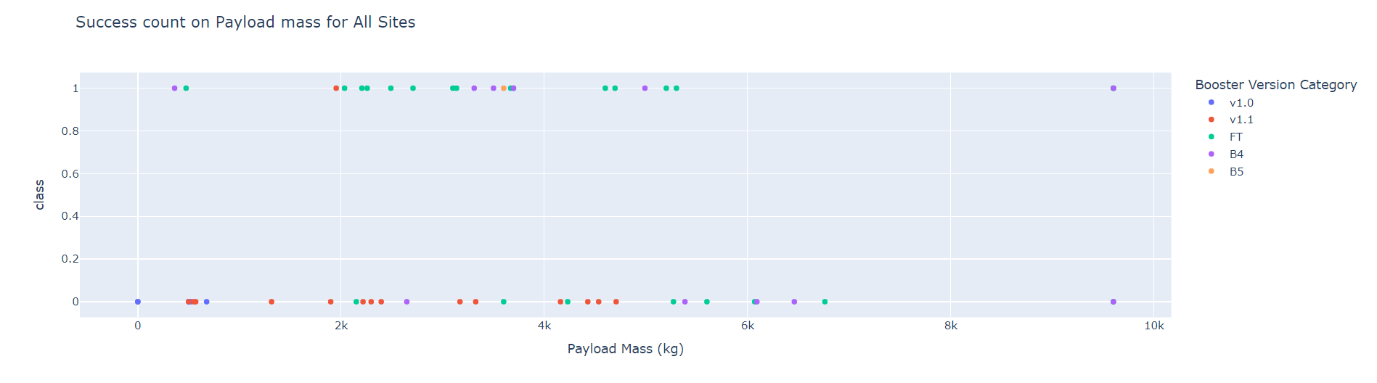
Interactive Dashboard with Plotly
We created a scatter plot to observe the correlation between payload and mission outcomes for selected site(s).
A payload range of 10K has the highest launch success rate while a payload range of 4K has the lowest launch success rate. The F9 Booster version v1.0 has the highest success rate.

Slide 32
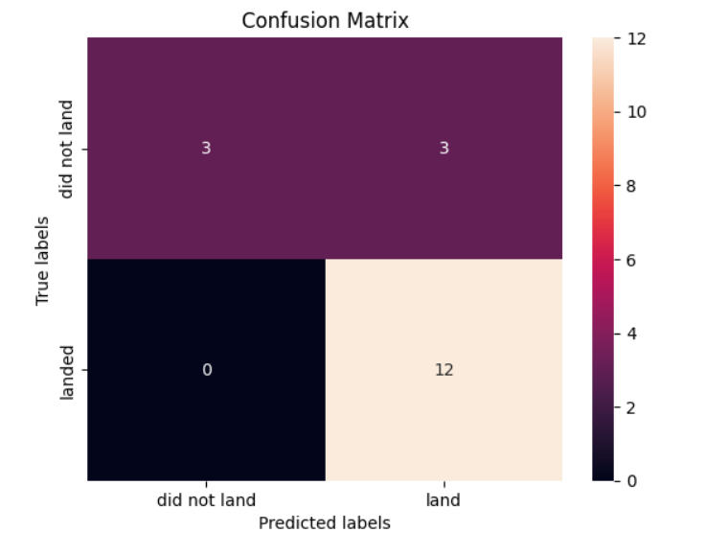
Machine Learning Prediction Analysis
Once we find out the accuracy score and best score for each classification algorithm, we get the following:
The Decision Tree algorithm has the highest accuracy of 0.94 with a best score of 0.9.
If we examine the decision matrix, we see that logistic regression can differentiate between classes. The major problem is that there are false positives.

Slide 33

CONCLUSION
Predictive Model Performance: Our machine learning model earned an accuracy of 90% in predicting Falcon 9 first stage landing success. This cost-effective approach significantly enhances decision-making during launch planning.
Cost Savings: By accurately forecasting landing outcomes, SpaceX can optimize booster reuse, leading to a decrease in overall mission costs. Estimated savings: $$$$$ millions per launch.
Future Work: Refine the model with data that has not been covered (weather conditions, historical launches, etc.). Examine transferability to other rocket systems.
Acknowledgments: Thanks to our team, mentors, and SpaceX for all their support.

Slide 34

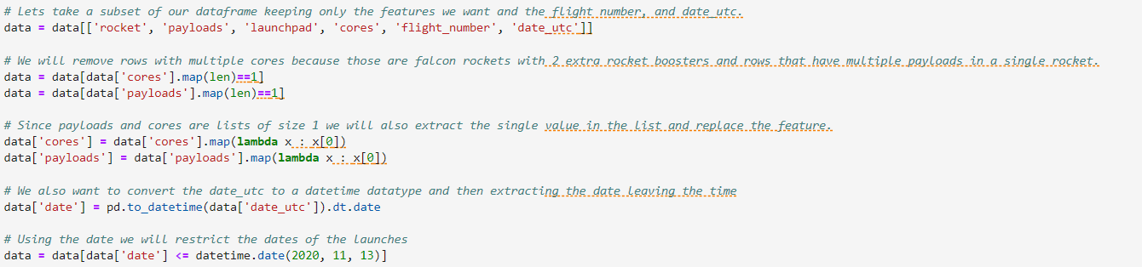
APPENDIX
SpaceX Data Collection API Code snippet for IDs given for each launch

Slide 35
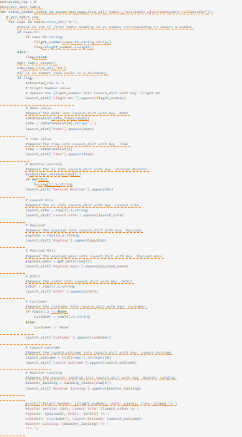
APPENDIX
Coding logic for parsing and extracting each launch table

